Slide 1

UML Component and Deployment Diagrams
Dr Rami Bahsoon
School of Computer Science,
University of Birmingham, UK
r.bahsoon@bham.ac.uk

Slide 2
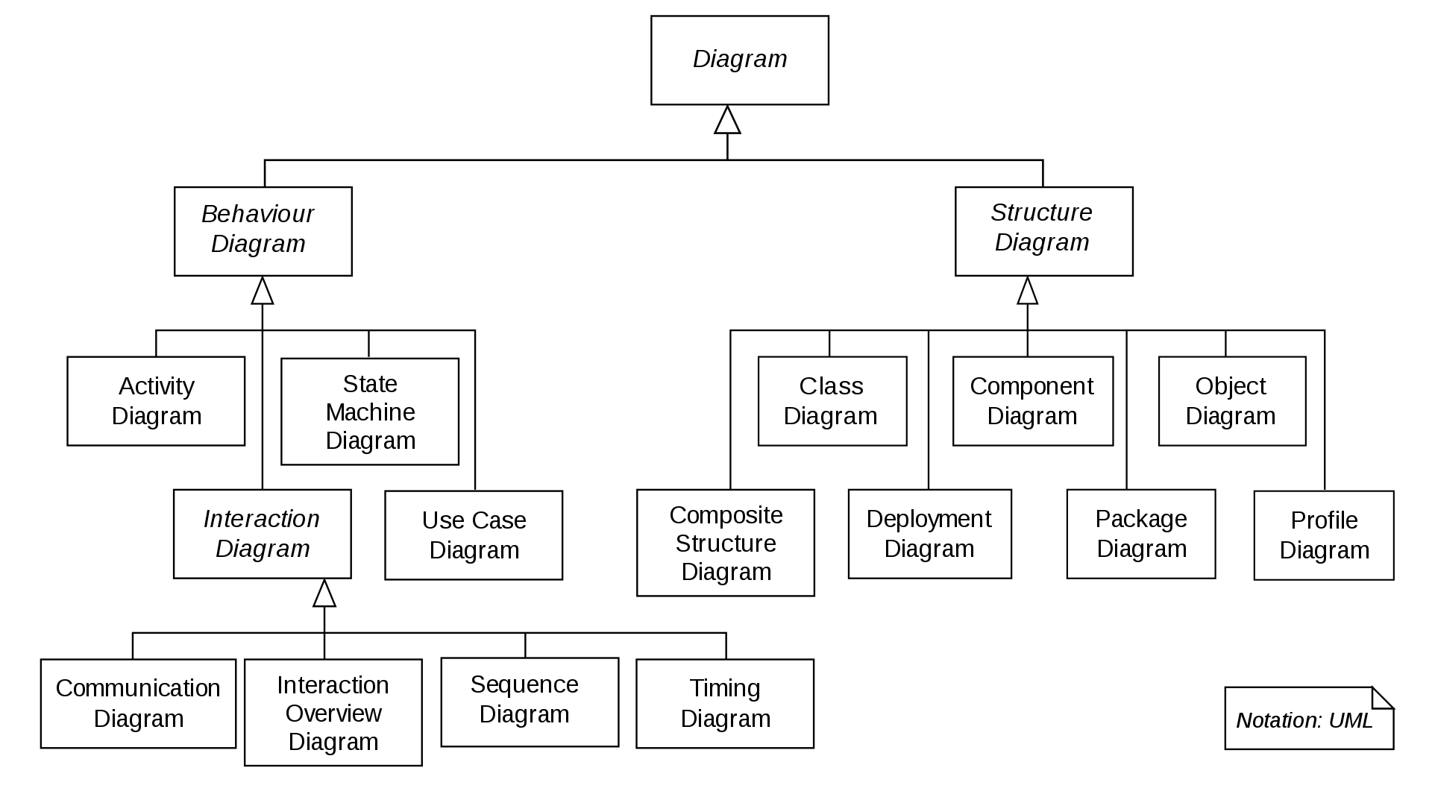
UML 2.X
UML 2.X
Collaboration Diagram

Slide 3
Component Diagram
The component diagram's main purpose is to show the structural relationships between the components of a system
Component diagrams offer architects a natural format to begin modeling a solution
Component diagrams allow an architect to verify that a system's required functionality is being implemented by components
Helps to reason about non-functionalties
Developers find the component diagram useful because it provides them with a high-level, architectural view of the system that they will be building

Slide 4
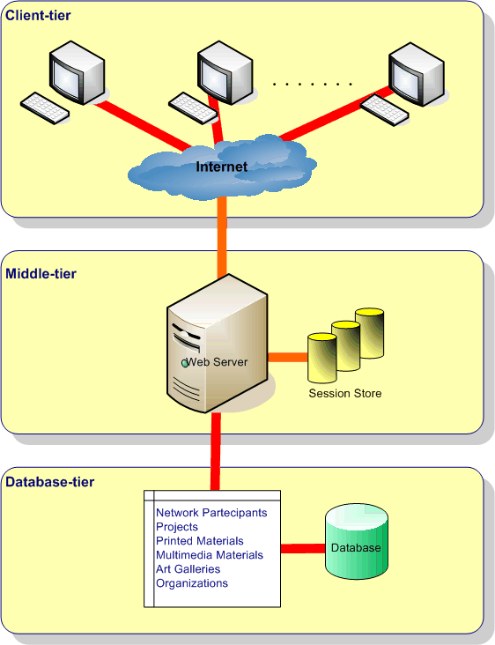
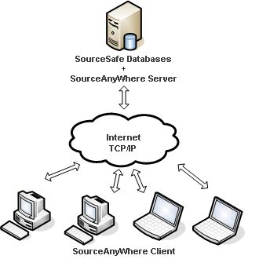
Architecture of the System
three-tier style
Client-server style

Slide 5
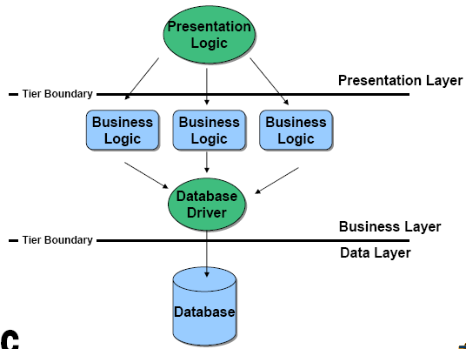
N-tier architecture & components
Reference: Ivica Crnkovic

Slide 6
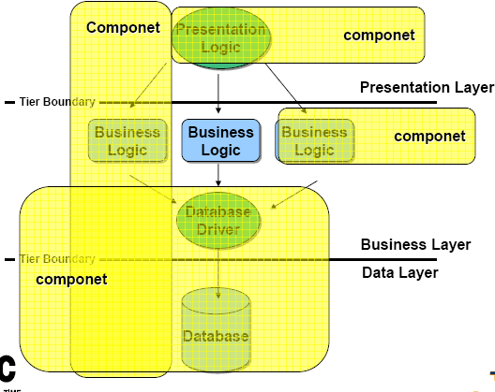
N-tier architecture & components
Reference: Ivica Crnkovic

Slide 7
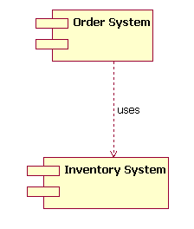
Component Diagram
shows a relationship between two components: an Order System component that uses the Inventory System component
UML version 1.4

Slide 8
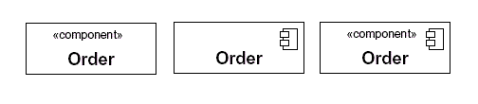
Component Diagram
All they mean the same: a component Order
UML version 2.0

Slide 9
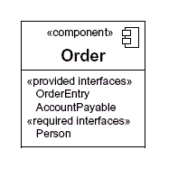
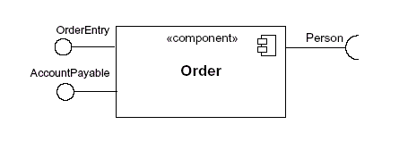
Required/Provide Interface

Slide 10
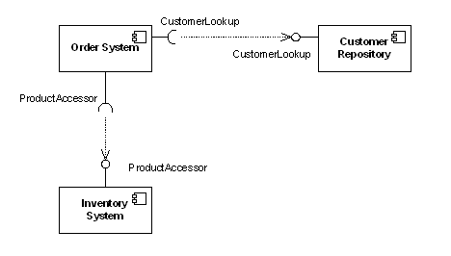
Component Diagram
showing a component's relationship with other components,
the lollipop and socket notation must also include a dependency arrow
(as used in the class diagram). On a component diagram with lollipops
and sockets, note that the dependency arrow comes out of the
consuming (requiring) socket and its arrow head connects
with the provider's lollipop

Slide 11
Components Diagrams
Architectural connection in UML 2.0 is expressed primarily in terms of interfaces
Interfaces are classifiers with operations but no attributes
Components have provided and required interfaces
Component implementations are said to realize their provided interfaces
A provided and required interface can be connected if the operations in the latter are a subset of those in the former, and the signatures of the associated operations are ‘compatible’
Ports provide access between external interfaces and internal structure of components
UML components can be used to model complex architectural connectors (like a CORBA ORB)

Slide 12
Component Diagrams
Ref: David Rosenblum, UCL

Slide 13
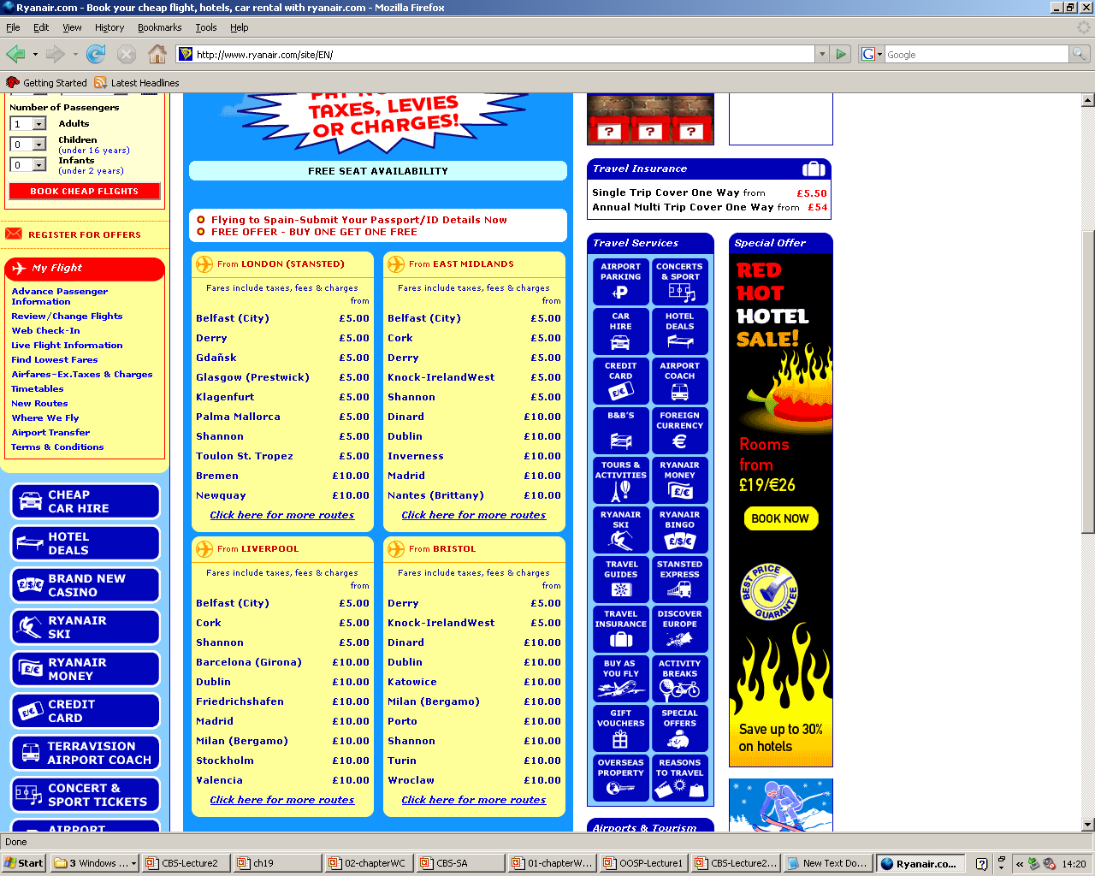
Exercise 1
Sketch the components and interfaces corresponding to the given services
Flight Booking service
Hotel Promotional Service
Car Hire Promotional Service

Slide 14
Exercise 1
Assume that Bob wants to book a holiday
Bob will book his holiday, where
He provides the following data: His origin airport, his destination, his dates of departure/return, and any other preference information (e.g., budget, luxury, etc)
Bob is interested in promotional offers for the period of his holiday
He wants to rent a car at his destination.
He wants to get good hotel deals during his stay.

Slide 15
Software Requirements
After you book a holiday, the company shall provide the holidaymaker with promotional services, which include hotel deals and car rent promotional service at the destination and for the duration of her/his stay

Slide 16
Flight Booking
Requires
Provides
Flight Information
Customer
Preference
Information
Customer data
Flight Booking

Slide 17
Promotional Hotel Booking Service..
Requires
Provides
List of available
Hotels
Flight Information
Promotional
Hotel Booking
Service
Customer Preference
Information

Slide 18
You can even provide more services..
Requires
Provides
List of available
Hotels
Flight Information
List of Budget
Hotel
Promotional
Hotel Booking
Service
List of Five stars
Customer Preference
Information
List of B&B
List of 3 stars

Slide 19
Car Hire Promotional Service
Requires
Provides
List of available
Car agents
Flight Information
Car Hire
Promotional
Service
List of cars deals
Customer Preference
Information

Slide 20
Gluing the components
Requires
Provides
List of
available
Car agents
Requires
Provides
Flight
Information
Flight Information
Car Hire
Promotional
Service
List of
cars
deals
Customer
Preference
Information
Customer
Preference
Information
Customer
data
Flight
Booking
Requires
Provides
List of available
Hotels
Flight
Information
List of Budget
Hotel
Promotional
Hotel
Booking
Service
List of Five star
Customer
Preference
Information
List of B&B
List of 3 stars

Slide 21
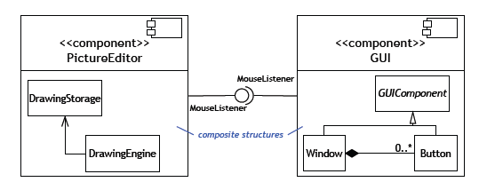
Composite Structure in Component Diagrams
A composite structure depicts the internal realisation of
component functionality
Ref: David Rosenblum, UCL

Slide 22
Ports
classes
The ports and connectors specify how component interfaces are
mapped to internal functionality
Note that these ‘connectors’ are rather limited, special cases of the ones
we’ve been considering in software architectures

Slide 23
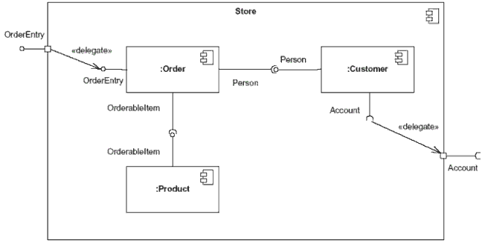
Ports
ports provide a way to model how component's provided/required interfaces relate to its internal parts

Slide 24
Ports
Connectors and ports also can be used to specify structure of component instantiations

Slide 25
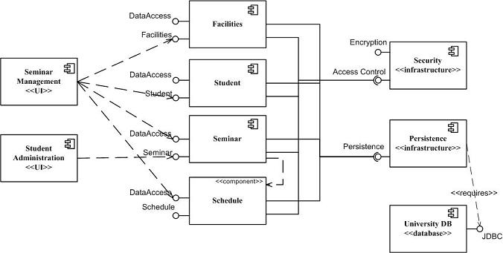
Example
Stereotype

Slide 26
Guidelines to Componentization
Keep components cohesive. A component should implement a single, related set of functionality.
This may be the user interface logic for a single user application, business classes comprising a large-scale domain concept, or technical classes representing a common infrastructure concept.
Assign user interface classes to application components.
User interface classes, those that implement screens, pages, or reports, as well as those that implement “glue logic”.
Assign technical classes to infrastructure components.
Technical classes, such as those that implement system-level services such as security, persistence, or middleware should be assigned to components which have the infrastructure stereotype.

Slide 27
Example
Infrastructure components
User interfaces assigned to application components

Slide 28
Guidelines to Componentization
Assign hierarchies to the same component.
99.9% of the time it makes sense to assign all of the classes of a hierarchy, either an inheritance hierarchy or a composition hierarchy, to the same component.
Identify business domain components.
Because you want to minimize network traffic to reduce the response time of your application, you want to design your business domain components in such a way that most of the information flow occurs within the components and not between them.
Business domain components = services
Identify the “collaboration type” of business classes.
Once you have identified the distribution type of each class, you are in a position to start identifying potential business domain components.

Slide 29
Example
Infrastructure components
Students, Facilities, Seminar, Schedule are
Business Domain Components

Slide 30
Guidelines to Componentization
Highly coupled classes belong in the same component.
When two classes collaborate frequently, this is an indication they should be in the same domain business component to reduce the network traffic between the two classes.
Minimize the size of the message flow between components.
Merge a component into its only client. If you have a domain component that is a server to only one other domain component, you may decide to combine the two components.
Define component contracts.
Each component will offer services to its clients, each such service is a component contract.

Slide 31
Guidelines to Componentization
Defining contacts
Highly coupled
classes
Highly coupled classes belong in the same component
Ref: David Rosenblum, UCL

Slide 32
UML Diagrams
Covered
Covered
Covered
Covered
Covered
Covered
We are here
Covered
Covered

Slide 33
Deployment Diagram
Models the run-time configuration in a static view and visualizes the distribution of components in an application
A component is deployed in which part of the software system architecture
In most cases, it involves modeling the hardware configurations together with the software components that lived on

Slide 34
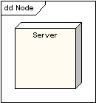
Node
A Node is either a hardware or software element. It is shown as a three-dimensional box shape, as shown below.

Slide 35
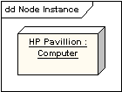
Node Instance
A node instance can be shown on a diagram.
An instance can be distinguished from a node by the fact that its name is underlined and has a colon before its base node type. An instance may or may not have a name before the colon.
The following diagram shows a named instance of a computer

Slide 36
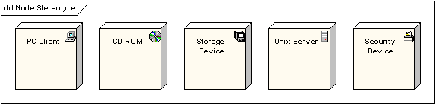
Node Stereotypes
A number of standard stereotypes are provided for nodes, namely «cdrom», «cd-rom», «computer», «disk array», «pc», «pc client», «pc server», «secure», «server», «storage», «unix server», «user pc». These will display an appropriate icon in the top right corner of the node symbol

Slide 37
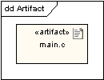
Artifact
An artifact is a product of the software development process. That may include process models (e.g. use case models, design models etc), source files, executables, design documents, test reports, prototypes, user manuals, etc.
An artifact is denoted by a rectangle showing the artifact name, the «artifact» keyword and a document icon, as shown below.

Slide 38
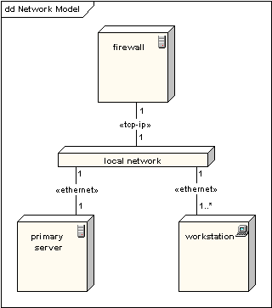
Association
In deployment diagram, an association represents a communication path between nodes. The following diagram shows a deployment diagram for a network, depicting network protocols as stereotypes, and multiplicities at the association ends.

Slide 39
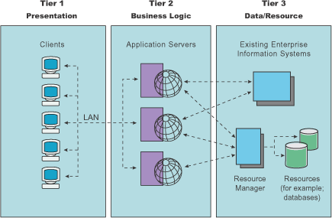
Example of three-tiers architectures
Many of real life web applications have three tier architectures

Slide 40
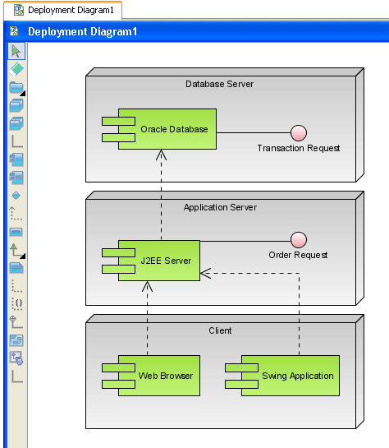
Deployment diagrams for three tiers
UML 1.4
Components deployed in an architecture

Slide 41
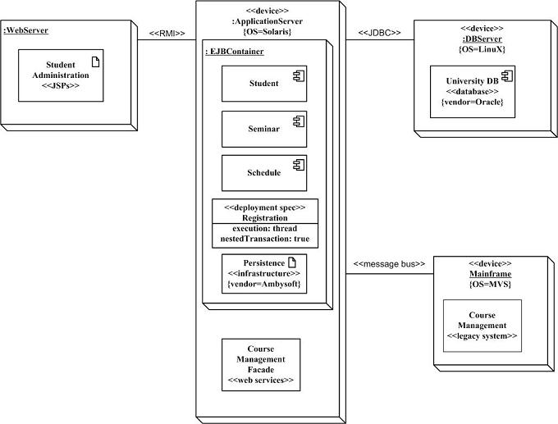
Example:

Slide 42
Example: Client server architectures

Slide 43
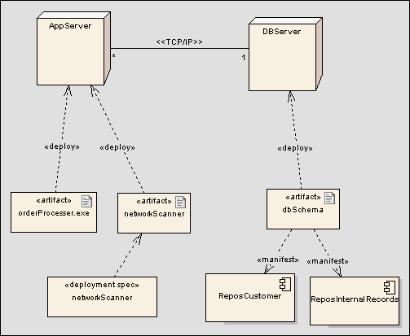
Example: Deployment diagram for a client server architecture
UML 2.0

